Slide 1
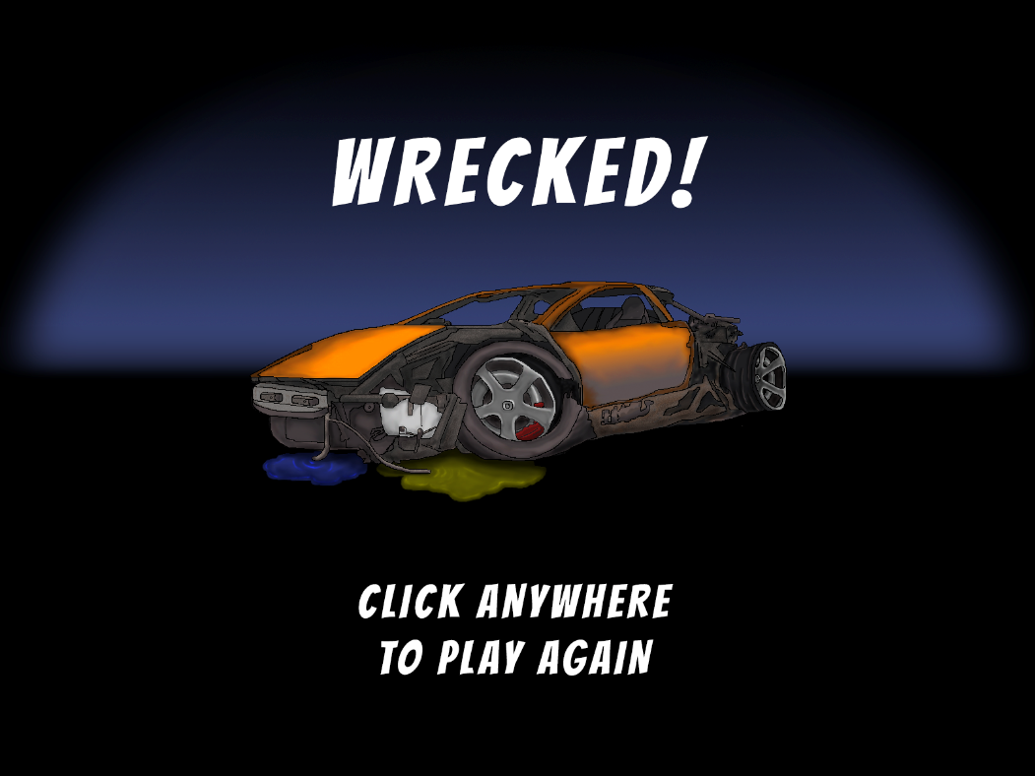
Little Racers
Pitch Date: June 22 , 2019 Week 7: 8/18/2019
Release Date: September 15, 2019 4 weeks to go!
Team Lead: Vince McKeown
20 contributors

Slide 2
Updates to Code
Vaan
Reset
Vince McKeown
Win Screen refactoring and new code
Time Records for each track
Player can enter name for records
Christer “McFunky Pants” Kaitila
Refactored CSS for mouse to click through overlay
Justin Horner
Fixed Mute code and added mute icon

Slide 3

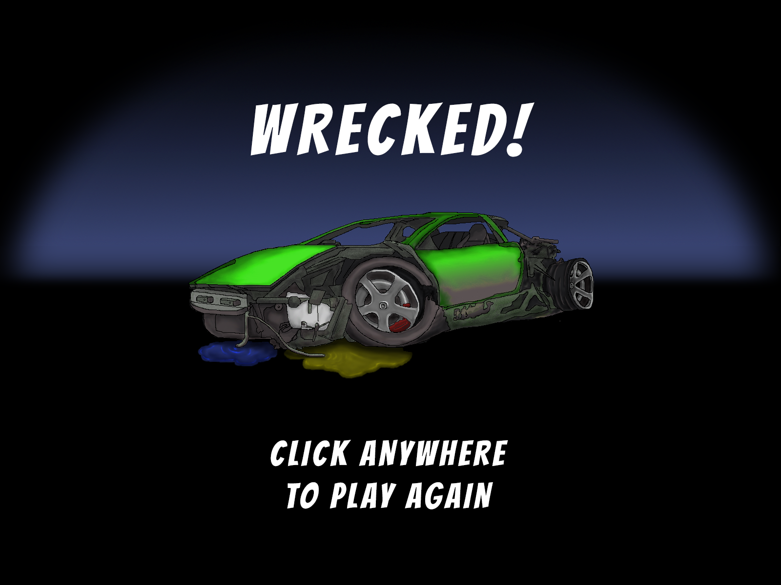


Updates to Art
Justin Horner
Vince McKeown
One for each car
Vince McKeown
Jeff Hanlon

Slide 4
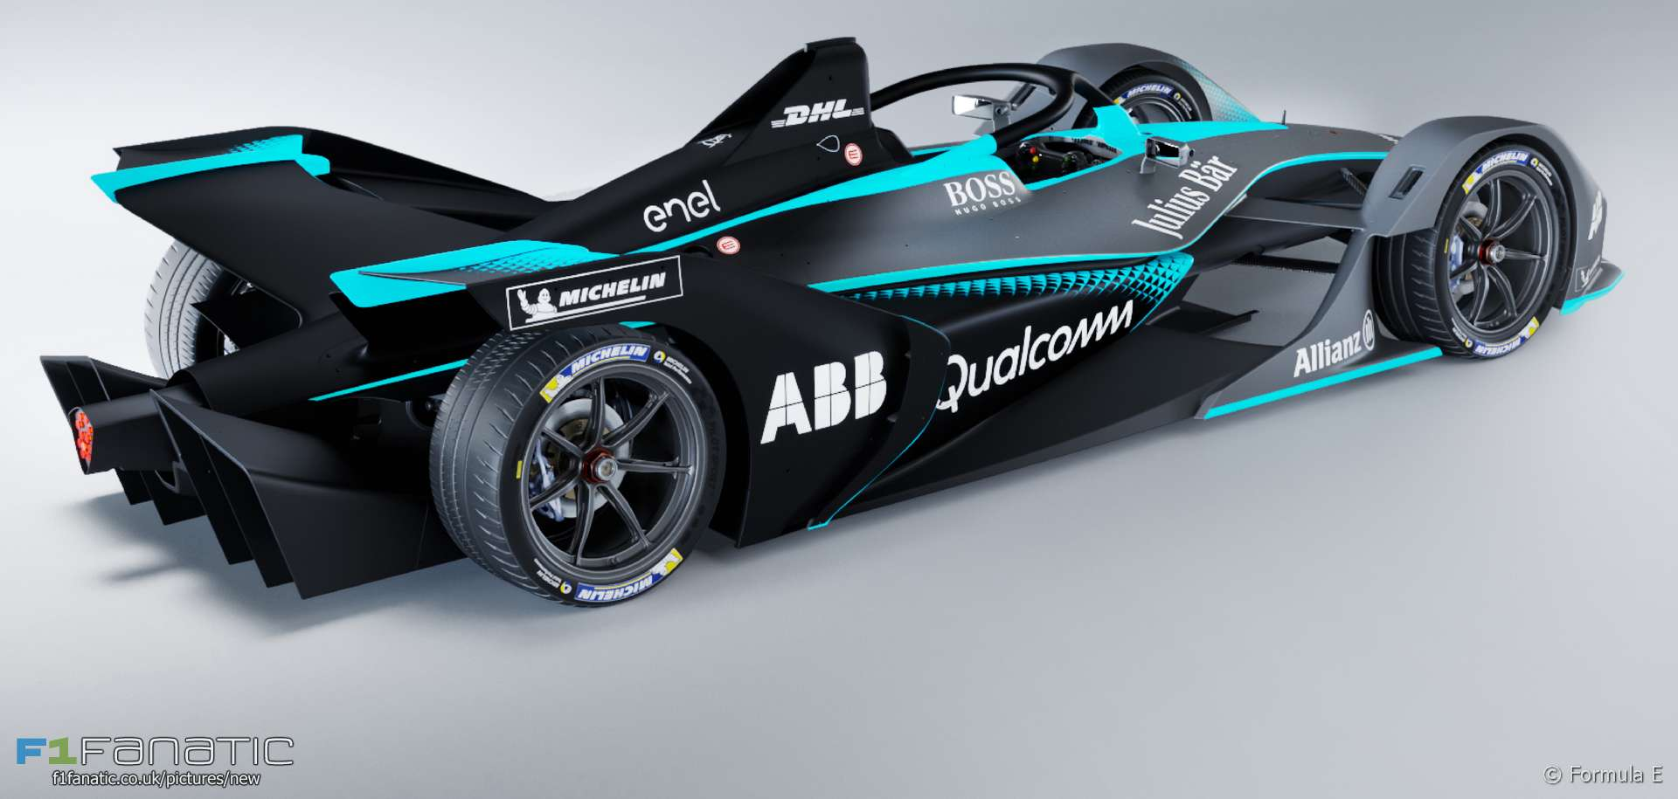
Demo
Cutover to Game

